Slide 1
The best place to open a vegetarian restaurant in Manhattan
Capstone Project - The Battle of Neighborhoods

Slide 2
A. Introduction
A.1 Vegetarian population in US and in NYC
A.2 Vegetarian dining environment
A.3 Open a new vegetarian restaurant in NYC

Slide 3
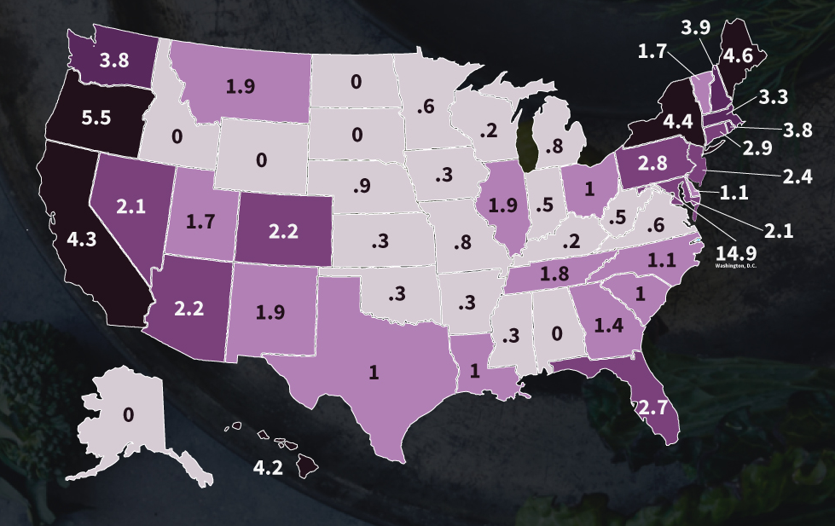
Vegetarian population by State

Slide 4
While many restaurants offer vegetarian dishes, many vegetarians prefer pure vegetarian restaurants.
They trust the food being prepared.
They enjoy the environment of pure vegetarian restaurants
Reference:
https://en.wikipedia.org/wiki/Vegetarianism

Slide 5
Problem statement
NY has very large vegetarian population
Vegetarians prefer dinning in vegetarian environment
So we’ll study which neighborhood is a best place to open a new restaurant in NYC( Manhattan)
Objective:
Find a neighborhood for new vegetarian restaurant
Goal:
Location of the new vegetarian restaurant should make access of vegetarian restaurants more convenient

Slide 6
Key issues
For our goal, we need to find out in each neighborhood :
1) How demanding are restaurants in general
2) Accessibility of vegetarian restaurant
The places where:
Restaurants are in high demanding
But has poor accessibility to vegetarian restaurants
Is the idea place for a new vegetarian restaurant.

Slide 7
Assumptions
We will use number of Restaurants are in a neighborhood to estimate degree of demanding of restaurants. A neighborhood has more restaurants implies it has more dementing of restaurants.
We will use the 2 following numbers to estimate the accessibility to vegetarian restaurants
Number of vegetarian restaurants in this neighborhood.
Number of vegetarian restaurants in nearby neighborhoods with consideration of accessible distance.

Slide 8
Planed Project Steps
Identify Manhattan on the map as data source geometrically.
Segment Manhattan into neighborhoods
Get all “Food” venues of each neighborhood from FourSquare.
Extract all restaurants for all neighborhood
Count all restaurants in each neighborhood
Count vegetarian restaurants in each neighborhood
Calculate vegetarian restaurants resource in each neighborhood
Plot vegetarian restaurants (lack, some sufficient) of neighborhoods on Map
Accessibility of vegetarian restaurant in each neighborhood
Location selections for a new vegetarian restaurant

Slide 9
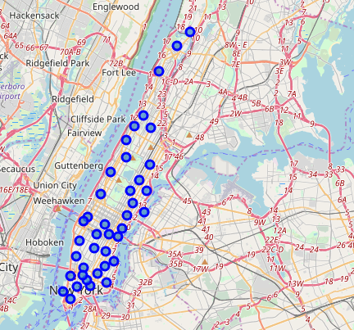
40 neighborhoods in Manhattan
Max distance of between nearest neighborhoods is 2196 meters

Slide 10
From FourSquare, we get all accessible venues of ‘food’ categories for each neighborhood
We defines ‘accessible’ for a neighborhood being with in a radius from the center of the neighborhood.
The radius being use is 1647 meters (0.75* Max distance of between nearest neighborhoods)
Note: there are overlaps, a venue could be counted as accessible for more than one neighborhoods. That is by design.

Slide 11
We filter out non-restaurant venues like Bakery etc.
We calculate total accessible restaurants for each neighborhood.
We calculate vegetarian restaurants for each neighborhood.
We calculated ratio of vegetarian restaurants against total number of restaurants

Slide 12
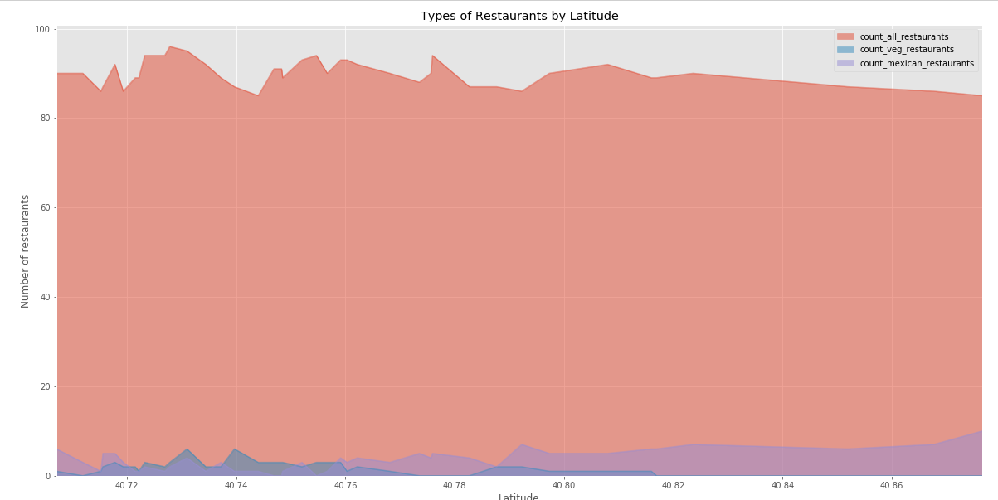
Numbers of total, vegetarian, Mexican restaurants, and by latitudes (From downtown to uptown)
Note: in the above graph, there are also number of Mexican restaurants for each neighborhood. This is for optional study of food style. But not use here.

Slide 13
Notes:
Since 3-D plotting may not be very clear in this case, we use 2-D plotting.
Manhattan is an elongated area, we plot by latitudes, form downtown to uptown
In the this graph, there are also number of Mexican restaurants for each neighborhood. This is for optional study of food style. But not use in this study.

Slide 14
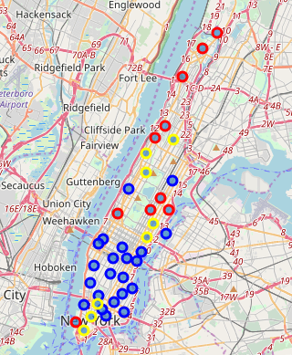
Numerically we can classify for each neighborhood, in terms of vegetarian restaurant resource by ratio of vegetarian to all restaurants.
Sufficient: more than mean value
Some: non-zero but less than mean value
Lack: zero value

Slide 15
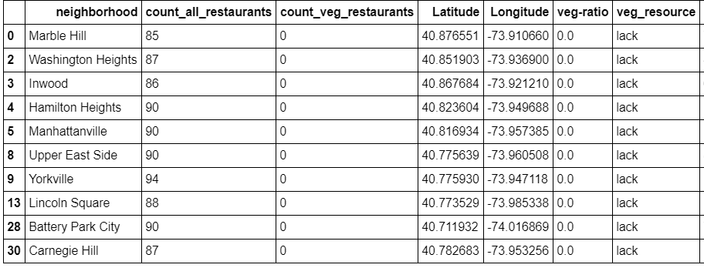
There are several neighborhoods has no vegetarian restaurants with in their own accessible radius. They are all candidate of for a new vegetarian restaurants.

Slide 16
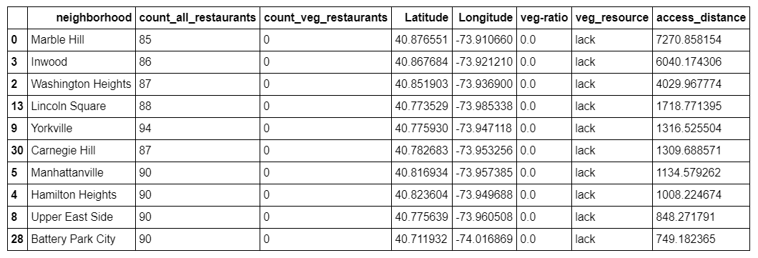
To determine which one is most needed, we look at their nearby
Define access_distance being the distance to nearest neighbor which has vegetarian restaurants.

Slide 17
Conclusion
Neighborhood Marble Hill has no vegetarian restaurant, it also longest distant to access nearby vegetarian restaurants. We recommend the following neighborhood to be the top candidate for new vegetarian restaurant.
Top Candidate: Marble Hill

Slide 18
Notebook shared link and Github link
https://dataplatform.cloud.ibm.com/analytics/notebooks/v2/0dca9b3d-6ff2-48de-8489-1c7da16f34f8/view?access_token=4384236afa11f2bb2ab302520c201cb873c5041fee15ee4ee93223b32e86e03d
https://gist.github.com/jjdawu/2a9ed0064214dd705ce13063a808c594

